Slide 1
CSF Creative Strategic Foresight
– Study Programme
1.10.2011 – 30.9.2013
EU
LLP-ERASMUS
Multilateral project
PROJECT NRO 517671-LLP-1-2011-1-FI-ERASMUS_FEXI
www.csf-studymodule.net
Project: www.muova.fi/csf

Slide 2
“It is very relevant to know everything about the process for finding an innovation because this is important for our future lives and also for our business careers.”
A bachelor student of international business at the Vaasa University of Applied Sciences

Slide 3
What is CSF?
A research-oriented study module which combines creativity with strategic thinking and applied research with education.
CSF brings together higher education – BA students and their teachers, companies, organisations and research.
To develop students’ competences to evaluate and foresee changes in business environment, foster students’ creative capacities into strategic thinking and become able to adapt the information and innovate.
To provide students with up-to-date applied research and entrepreneurial information
From analytic towards creative thinking
Tertiary education
Language: English, Spanish
Notes:
Based on the need of innovative and creative workforce, ability to adapt to changes
3

Slide 4
…thus it also aims to
Develop a model how to combine research with
education to develop new, innovative ideas.
Provide a plan how to integrate the project results with the world of enterprises
To contribute to integration of creativity into European curricula
Notes:
Objective 1
The state of art, benchmarking and competences of the project partners will provide a solid background for this objective. The focus will be on workpackages (WP) 2 and 3. The relevance and the quality of the study module will be tested and evaluated in the WP 4 and 5.
To address this problem, Creative Strategic Foresight-project (CSF) will focus on developing and testing a study module which will combine creativity with strategic thinking as well as applied research with education.
Students become able to identify core challenges in specific sectors, for instance, by listening researchers who open up their research findings, and by inviting different stakeholders, such as companies and policy makers, to discuss about the challenges in workshops, and e.g. inviting students to participate in research.
These actions will be planned and designed in the WP 2-3, and tested and evaluated in the WP 4-5. The testing and evaluation results will be used for development, dissemination and exploitation purposes in the relevant workpackages.

Slide 5
Who is it for
Teachers and bachelor students at the tertiary level
Students → increased competences to combine strategic foresight, creativity and research knowledge in their working lives
Teachers → increased competences to support students learning within the knowledge triangle, and knowledge of applying creativity and research in teaching.
Researchers → increased knowledge of how to implement the results, and upgraded researchers’ educational skills.
Companies and other organizations → increased innovation and research knowledge in the companies, and understanding how to better cooperate with education.
Notes:
1.Students and teachers
website, newsletters, seminars, papers and publications of the field, and personal contacts , information events, testing the module.
In addition partner universities will be reached via a private project e-working area, workshops, testing and content development: during the WP 2 and 3, a testing group of teachers and students will be selected among the partner universities. They will implement and evaluate the study programme.
2. Researchers at the partner universities but also in research
- website, newsletters, publications, events and personal contacts and meetings, the researchers will be reached by inviting them to give lectures and guide student workshops during the WP 3.
3. Companies and other organizations which will be contacted during the WP 2 and 3 and invited to attend the workshops together with students. Companies and organizations are asked to present problems and challenges in their competitive environment which students can focus on solving. The expected impact is increased innovation and research knowledge in the companies, and understanding how to better cooperate with education.
This target group will also be reached via the project website, newsletters, publications, events and personal contacts and meetings.

Slide 6
Overall expected impact
Decreased barriers of cooperation between the target groups.
Shared and increased knowledge of each others’ activities and competences, what to obtain from each other and how to better cooperate with each other, e.g. via models of cooperation.
Competences, skills, knowledge and possibility to profit professionally
A database of cases suggested by researchers, companies and organisations
Information how to combine research with education and business life
Notes:
Indicators, short- and long-term
quantitative- the number of representatives of target groups involved
qualitative indicators: the quality and depth of their involvement and increased understanding.

Slide 7
CSF approach
Strategic thinking, not product development
Idea lens*= strategy is not defined by the management, but by changes in the environment. All employees should participate in strategic thinking.
A realistic and enterprise and society oriented framework
Combining applied research and education, creative tools, environmental scanning and entrepreneurial viewpoint
*Johnson, Scholes and Whittington (2006). Exploring corporate strategy. Pearson Prentice Hall.
Notes:
Researchers involved in teaching
Students participating in applied research
Companies and other organisations provide/ are used as material for research and education
a toolbox of innovation methods, such as strategic roadmaps, user research, new technology research and environmental scanning.
Idea lens = strategy is not defined by the management, but by changes in the environment (e.g. in the context of customers, competitors and suppliers), and all employees should participate in strategic thinking. Idea lens is the basis for this project: we aim to develop the creative competences of future employees so that they are better able to engage with strategic development of their workplaces. They need to know, for instance, how to evaluate the environment and changes in it, how to use this information to develop the organization, and how to interpret things creatively, from different perspectives.
7. Johnson, Scholes ja Whittington (2006). Exploring corporate strategy. Pearson Prentice Hall.

Slide 8
Courses and pedagogic background
of the CSF Study Module
The CSF Study Module is based on problem-based learning.
The learning process is structured around applied research and business-life oriented information.
Creativity and multidisciplinarity are used to solve real-life company challenges, and generate new insights and the development of holistic thinking.
CSF Study Module combines face-to-face and virtual learning.
The modular structure of the CSF Study Module provides an opportunity to apply CSF to different disciplines.
The CSF Study Module is provided in English and in Spanish.
The CSF Study Module comprises of six different courses, a kick off – introductory course and final task which combines what has been learnt and functions as demonstration of the learning.
Notes:
Researchers involved in teaching
Students participating in applied research
Companies and other organisations provide/ are used as material for research and education
a toolbox of innovation methods, such as strategic roadmaps, user research, new technology research and environmental scanning.
Idea lens = strategy is not defined by the management, but by changes in the environment (e.g. in the context of customers, competitors and suppliers), and all employees should participate in strategic thinking. Idea lens is the basis for this project: we aim to develop the creative competences of future employees so that they are better able to engage with strategic development of their workplaces. They need to know, for instance, how to evaluate the environment and changes in it, how to use this information to develop the organization, and how to interpret things creatively, from different perspectives.
7. Johnson, Scholes ja Whittington (2006). Exploring corporate strategy. Pearson Prentice Hall.
8

Slide 9
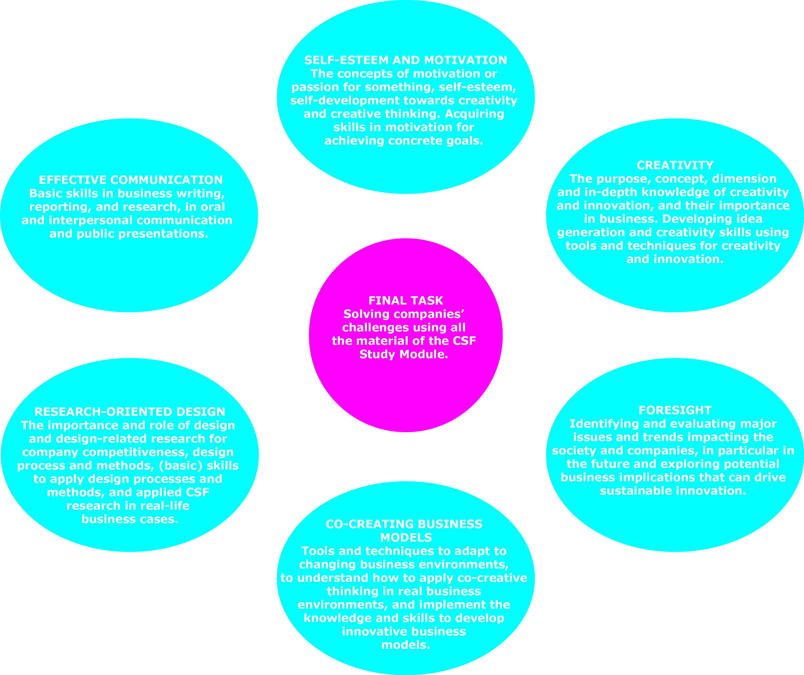
The CSF courses
CSF KICK-OFF COURSE
What is CSF about, opening minds, try-out

Slide 10
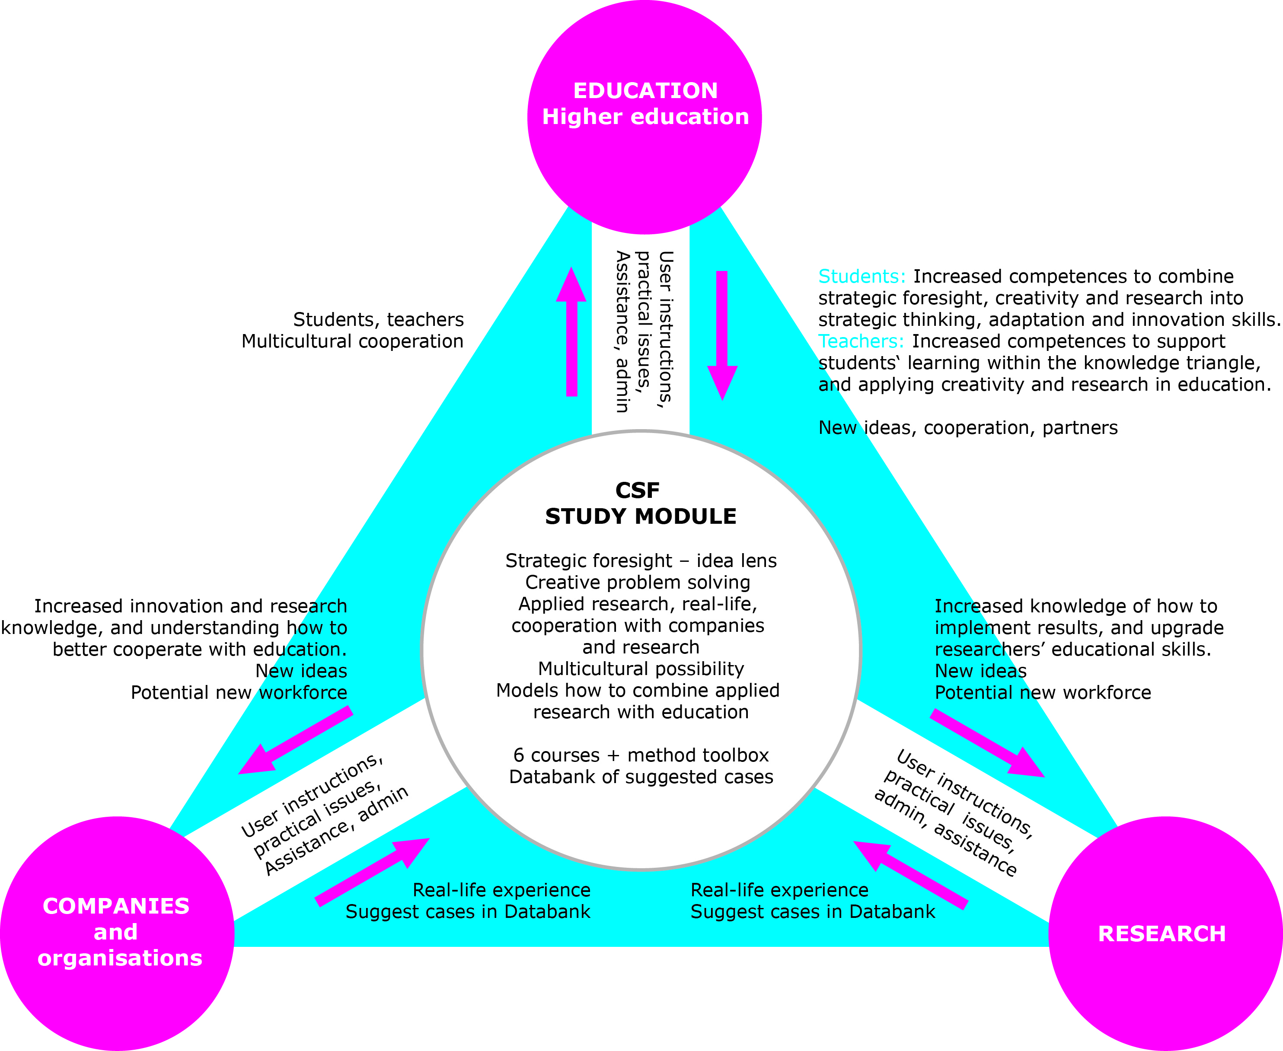
CSF module and
cooperation structure

Slide 11
CSF virtual process and website structure

Slide 12
CSF and EU policies
EU 2020 flagship initiative of smart growth:
innovative , creative and knowledge based economy in which education has a central role
more competitive by creating new jobs and the preconditions for future jobs.
ET 2020:
Knowledge triangle where education, research and innovation meet
Skills for future jobs
EU 2020: European Commission (2010). Communication from the Commission,
EUROPE 2020 A strategy for smart, sustainable and inclusive growth (Brussels,
3.3.2010; COM(2010) 2020); retrieved from
http://eunec.vlor.be/detail_bestanden/doc014%20Europe%202020.pdf; on 28.3.2011
Education and Training 2020: Notices from European Union institutions and bodies
2009. Council conclusions of 12 May 2009 on a strategic framework for European
cooperation in education and training (‘ET 2020’). http://eur-
lex.europa.eu/LexUriServ/LexUriServ.do?uri=OJ:C:2009:119:0002:0010:EN:PDF

Slide 13
8 key competences of LLP
Sense of initiative and entrepreneurship
Communication in mother tongue and foreign languages: e.g. expressing and communicating ideas
Mathematical competence and basic competences in science and technology
Digital competence
Learning to learn
Cultural awareness and expression
Social and civic competences
EU Key competencies for lifelong learning: Retrieved from http://europa.eu/legislation_summaries/education_training_youth/lifelong_learning/c11090_en.htm; on 18.04.2011

Slide 14
CSF and ET2020
Creativity and innovation within the higher education
Knowledge triangle
Applied research
Communication in a foreign language and digital competences: e.g. blended learning.
Linkages to other actions:
Exploiting ICT in learning
Notes:
14

Slide 15
Website and get in touch
CSF Study Module: www.csf-studymodule.net
Email: admin@csf-studymodule.net
The project website: www.muova.fi/csf

Slide 16
CSF project consortium
P1 Western Finland Design Centre Muova (Aalto
University School of Arts, Design and Architecture)
P2 Vaasa University of Applied Sciences VAMK
P3 -
P4 University of Primorska, The Faculty of Management
Koper UP FM
P5 Zealand Institute of Business and Technology,
Campus Roskilde (Business & IT) ZIBAT
P6 Institute for postgraduate studies - division at
UNWE, Management Skills Development Centre
P7 F2INNOVA, S.L, Project department
Associative partners
Vaasa University, Open University
Vaasa Region Development Company VASEK

Slide 17
Contact information
Coordinator contact information
Tanja Oraviita
Mob. +358 40 7450828
Fax. +358 6 312 8664
Skype: tanjaorav
E-mail: tanja.oraviita@aalto.fi
Western Finland design centre MUOVA
(Aalto University School of Arts, Design and Architecture – University of Vaasa)
Wolffintie 36 A | 65200 Vaasa | Finland

Slide 18
Thank you!
www.muova.fi/csf
This project has been funded with support from the European Commission. This publication [communication] reflects the views only of the author, and the Commission cannot be held responsible for any use which may be made of the information contained therein.
© Creative Strategic Foresight CSF

