Slide 1
CSF Creative Strategic Foresight
Study Module
KICK-OFF COURSE
By Aalto University
EU LLP ERASMUS
Multilateral projects
PROJECT NRO 517671-LLP-1-2011-1-FI-ERASMUS_FEXI
www.csf-studymodule.net
Notes:
This is the kick-off introductory course for the Creative Strategic Foresight Study Module (CSF). Its aim is to open minds towards the areas of the CSF Study Module and creativity, thinking beyond traditional academic solutions only. Creativity is about open-ended solutions and the greatest creative minds have always been rebellious. Like Albert Einstein said "The true sign of intelligence is not knowledge but imagination".

Slide 2
“The true sign of intelligence is not knowledge but
imagination"
Albert Einstein
Notes:
This course is about CSF. All CSF suffer from influction. Creativity has become the *IT* word for yuppies and anyone but the most creative ones; Foresight – trends is found in the blogs of any fashion victim’ teen girl bloggers and ’Strategy’ seems to have been forgotten its common sense – application roots. This kick-off course aims simply to guide your thinking away from the academic only and to reflect the core essence of Creativity, Strategy and Foresight. Don’t get me wrong, academis is not bad, but it is not enough. It leaves to average. The best outcomes have always been achieved by ditching the ’good girl’ or the ’good boy’. But instead going beyond the academics.
2

Slide 3
Superficial seriousness gets you nowhere
Difference between the superficial seriousness and responsibility of implementation
Serious faces and aggressive cocky attitude kill trust and creativity (and makes one look like a fool)
“Heart-brain” connection
The importance of the flow-state
Pointing on efficiency only bounces back as waste of time and results
Pixie/ Joker effect: Silly becomes the most rational and profitable
Silliness, non bourgeois, liberal, ‘punk’ etc. attitude usually lead to best outcomes

Slide 4
Pixie attitude in our every day lives 1
Think about the following examples:
Richard Branson: Virgin
Art of the Fin and Debut de Siècle: Gaugain, Picasso, Monet, Van Gogh, etc. the dramatic change in the arts towards the modern
Breaking from the rules, lot of informal action, absinthe
The Young Ones and the Absolutely Fabulous: icons of the British and European comedy
The Young Ones for example got its begin in a pub
Science Fiction → numerous development ideas for science and development thanks to the ‘geeks’
e.g. distance 3D printing of medicine
Telepathy: ‘goofy’ made into communication for injured

Slide 5
Pixie attitude in our every day lives 2
The world of computers, Microsoft, Apple: school ‘drop outs’
Skip the school to focus on your passion
New trends in lifestyle and thinking, e.g. New Age
Woodstock: a messy rock festival became a cultural icon
Metaphors and play can be the source of inspiration in product development and design, e.g. filing the hole with a gum→ rubber like material and solution developed
Note the societal cultural value of the examples.
Activity!
Find out other examples and discuss about them!

Slide 6
Creativity – how others see it
Examples of presumptions:
Irresponsible people – probably drunk or high on drugs too
No need of responsibility
No need of precision, attention to detail nor business sense required
No schedules
It is ok to miss the deadlines
Only for artistic sector
No importance for national economics
Waste of time
You know all about creativity by reading books and theory only

Slide 7
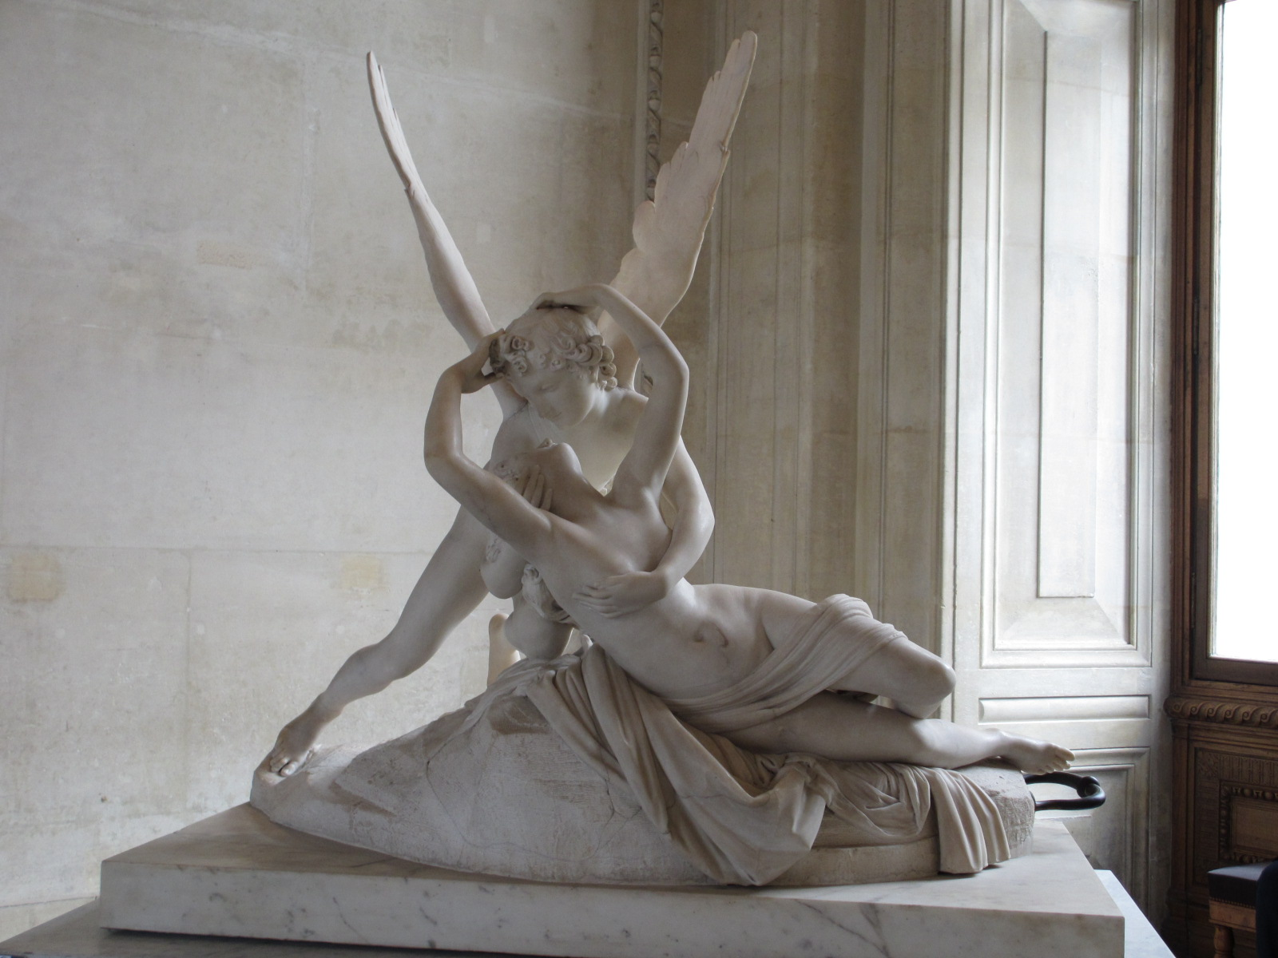
Canova: Psyche Revived by Cupid's Kiss (1787)

Slide 8
Creativity – how it really is
”The fashion industry is war. That’s why we have to take no prisoners kind of attitude”
“This isn’t college! This is millions of dollars of people’s money!”
“What the fashions world looks like and what the business is, are two completely different things. They all come in thinking they are fashion people. And 90% of are going to find out that they are not.”
“We have a line up for a reason”
“It’s officially fashion week. It is no f***ing joke. I am playing with b**** b*****b***ing kids”,
“It’s fashion week. So wake up!”
“Is that clear!”
- All quotes by Kelly Cutrone

Slide 9
Creativity – how it really is 2
Swim or sink: high competition and only a few on the top
High requirements, responsibilities and pace
The results must be delivered in an agreed manner, on agreed quality and by agreed deadlines, or you lose the trust + business
Deadlines and schedules
Business is important: For example the European economy and brand has always been strongly based on the creative sector
Fast adaptation, quick thinking and constant problem solving
Attention to detail and big picture co-exist and must be applied constantly; keeping all balls in the air at the same time
Creativity is and should be present on each sector
Creative people are driven by passion to finish the works with optimal results
Understanding and practice, open minds are needed

Slide 10
Creativity – to think about
Select a creative sector and observe it. Think about the following things in groups and exchange the ideas and results:
How are the outcomes for the sector?
What core processes are be needed to obtain the outcomes?
What assisting process are be needed to obtain the outcomes? (e.g. raw materials, publishing, volunteers, medical assistance, legal issues…)
What is the work pace of the sector?
What kind of people work in different tasks? What is required from them?
What kind of stress managing is needed in the sector?
Would you be able to work in the sector, as personality?
Which position could you work at? What kind of skills would you need to work within the sector?
Activity: Brainstorm creative solutions in any sector,
small scale preference

Slide 11
Strategy
Everyday translation:
Do not jump into the water without asking about the rocks; dress according to the weather; plan what you shop who you need to contact etc.
Military based
Common sense going from A to B
Examples from the animal kingdom:
Cats hunting
Bird migration
Dogs stealing your sandwich
Notes:
This is the kick-off introductory course for the Creative Strategic Foresight Study Module (CSF). Its aim is to open minds towards the areas of the CSF Study Module and creativity, thinking beyond traditional academic solutions only. Creativity is about open-ended solutions and the greatest creative minds have always been rebellious. Like Albert Einstein said "The true sign of intelligence is not knowledge but imagination".

Slide 12
Strategy exercise
Make a strategy for one of the following
Getting to Mount Everest
Abuse intervention for someone
Wedding
Travelling across a continent (e.g. North America)
Re-launch a product or person with a politically or morally questionable image

Slide 13
Strategy, issues to think during task
The Objective - what do we want to do (objective)
Why do we want to do (objective)
When do we want to do it (steps, timing, deadline)
Also subgoals and milestones (steps)
How do we want to do (steps)
How can we do it and do we have skills
Who to involve and why, what are the responsibilites and resources
What do we do in case of problems, what kinds of solutions

Slide 14
Foresight
It was, it is and it is gonna be
Curiosity towards novelties
Strong human dimension: behaviour, aspirations, fears, habits, examples to follow…
Chase and imitation
Torstein Veblen and conspicuous consumption
Scenarios and alternative realities
E.g. culture, subcultures, availability, nature
Do not exclude anything

Slide 15
Foresight – to think about…
Two tasks for discussions:
Task a
Select an object or an concept (thing)
Make a timeline for it, how it was and how people (users, non-users) were at each point of the timeline
E.g. 20, 50, 100 and 500 years ago
Discuss about your findings, how the society and people have influenced in it.
Task b
1. Select an object or an immaterial thing/idea. Make 3 future scenarios for it including users and the state of the society
Discuss about the results.

Slide 16
Walk the walk, talk the talk
Implementation
Production process
Think about all the possible aspects
Look calmly the situation, think over and act
Acting too impatient may lead to wasting time and compromising on results
Assuming responsibilities
No project fairies
Activity! Project implementation game

Slide 17
CSF try out
Activity! This is a quick brainstorming based exercise to introduce you to different aspects of the CSF Study Module
Select an objet or a thing. It should have business potential
Create 3 alternative future scenarios for the outcome using creativity as a method. The solution should be future oriented and strategic
When working on the solution, take into account
Effective communication – including whom you communicate to
What drives your motivation and why
Co-creation in developing innovative future business models
User orientation (what would it be for the users, why, how would they feel, what kind of users)*
Present and discuss about the scenarios
* User orientation will be part of the Research-oriented design. Thus presented
here as one of the methods approaches

Slide 18
Reading and feed your spirit
Read, observe, listen and watch anything to give you fresh viewpoints and going towards unusual thought patterns: everything from science magazines, foreign documentaries and gossips who is in and out and what do people comment about it.
Here are some examples of books to read:
Massive chance: A manifesto for the Future of Global Design, by Bruce Mau
If You Have to Cry Go Outside, by Kelly Cutrone. A window to the mind of a fashion publicist, i.e. highly creative and strategic person
The Evolution Man, by Roy Lewis
Choose one of the books in your reading circles. Read the book and discuss about the fresh viewpoints it brings, and how these are linked to Creativity, Strategy and Foresight.

Slide 19
Thank you!
This project has been funded with support from the European Commission.
This publication reflects the views only of the author, and the Commission cannot be held responsible for any use which may be made of the information contained therein.
© Creative Strategic Foresight CSF

